Slide 1
ArGEnCo /Urban and Environmental Engineering
General presentation
Notes:
PAGE D'INTRODUCTION 1 / page permettant l'insertion du titre de la présentation ainsi que d'autres infos (date, lieu, orateur, sous-titre,…)
Si vous souhaitez modifier la photo de fond :
Allez dans le menu « Affichage » > « Masques » > « Masque des diapositives »
Supprimez l’image du drapeau déjà présente
Allez dans « Insertion » > « Photo » et chargez votre image (en veillant à la bonne qualité de celle-ci)
Placez celle-ci en « Arrière-plan » via le menu « Réorganiser »

Slide 2
Notes:
CHIFFRES-CLÉS ANGLAIS / PAGE 1

Slide 3
Notes:
CHIFFRES-CLÉS ANGLAIS / PAGE 2

Slide 4
Notes:
CHIFFRES-CLÉS ANGLAIS / PAGE 3

Slide 5
Department or research unit?
Department = in charge of teaching activities
Department name = ArGEnCo
(for Architecture, Geology, Environment and Constructions)
Research Unit = in charge of the research activities
Research Unit name = Urban and Environmental Engineering
But same people behind…
Notes:
PAGE DE CONTENU 1 / Possibilité d'insérer du texte, des images, de la vidéo, des graphiques …

Slide 6
Institutional context
1 out of the 4 research units
of the ULiège Faculty of Applied Sciences
(School of Engineering
and Computer Science)
Notes:
PAGE DE CONTENU 2 / Possibilité d'insérer, en deux colonnes, du texte, des images, de la vidéo, des graphiques …

Slide 7
About our teaching
Notes:
Remplacer par une photo plus actuelle

Slide 8
Master programs
3 civil engineer master degrees
Geology and Mining Engineering
Civil Engineering
Architectural Engineering
2 specialized master’s degrees
Urban and regional planning
Transportation management
Ongoing education programs
Auscultation et réparation des ouvrages en béton
BIM
European accreditation
EUR-ACE Label & CTI
Notes:
Vérifier si les masters de spécialisation existent toujours

Slide 9
Standard organization of the academic year
1st quadrimestre
Christmas holidays
exams
2nd quadrimestre
Summer holidays
(Exams)
Exams
From mid-September
to end of December
From February
to mid-May
Notes:
Vérifier si les masters de spécialisation existent toujourq

Slide 10
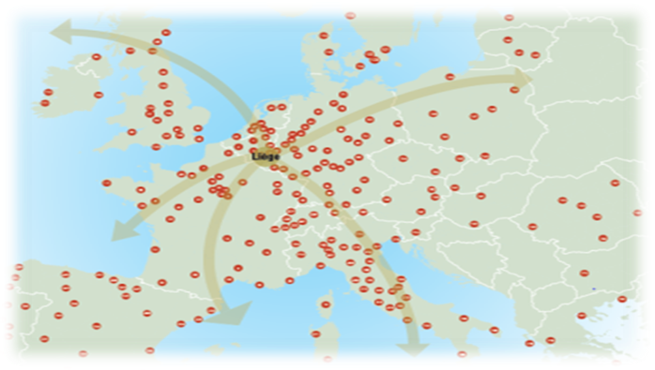
International education programs
Erasmus Mundus
AMIR
EMERALD (Uliège, Freiberg, U. de Lorraine, Luleå U. of Tech)
EMShip (ULiège, EC Nantes, U. of Galati, U. of Genoa, U. of Rostock, West Pomeranian University of Technology)
Erasmus exchanges
Codiplomation (UBologne)
Notes:
Parler également des passerelles dans le cadre du master ingénieur architecte?
Actualiser le visueil

Slide 11
A global pedagogical approach
Strong theoritical background
but also lectures, training sessions, group assignments, integrated projects, hands-on experiments, large scale individual master projet, internship
Notes:
Field work? Raccourcir l’énumération, actuellement un peu trop longue

Slide 12
Master in Architectural Engineering
Bloc 1
60 ECTS - Common courses
Bloc 2
30 ECTS - Common course Ms Thesis, internship, project
30 ECTS – Option of your choice
Option 1: Architectural and Urban Enginering | Option 2: Urban and Environmental Engineering
Notes:
Field work? Raccourcir l’énumération, actuellement un peu trop longue

Slide 13
Master in Civil Engineering
Bloc 1
60 ECTS - Common courses
Bloc 2
30 ECTS - Common course Ms Thesis, internship
30 ECTS – Option of your choice
Option 1: Civil Engineering | Option 2: Urban and Environmental Engineering
Notes:
Field work? Raccourcir l’énumération, actuellement un peu trop longue

Slide 14
Master in Geological Engineering
Bloc 1
30 ECTS - Common courses
20 ECTS – Option of your choice
Option 1: Mineral resources & recycling | Option 2 : Environmental and Geologicial Engineering
10 ECTS – Elected courses
Bloc 2
30 ECTS - Common courses Including Ms Thesis, internship
10 ECTS – Option of your choice
Option 1: Mineral resources & recycling |  | Option 2 : Environmental and Geologicial Engineering
10 ECTS – Elected courses
Notes:
Field work? Raccourcir l’énumération, actuellement un peu trop longue

Slide 15
About our research
Notes:
Parler également des passerelles dans le cadre du master ingénieur architecte?
Actualiser le visueil

Slide 16
Our research goals in a nutshell
Developing advanced scientific methods and experimental protocols aimed at fostering a sustainable development, transformation and exploitation of built and natural environments.
Our research activities typically combine theoretical and numerical modelling, laboratory experiments and field tests to deliver highly innovative simulation, characterization, processes, design or decision-making tools.
Based on a close partnership with a wide range of enterprises/institutions and on fundamental research funding. Research and teaching & training activities are intimately linked and mutually benefit from each other.
Notes:
Parler également des passerelles dans le cadre du master ingénieur architecte?
Actualiser le visueil

Slide 17
Some key figures about us
180 people
26 academics or associated professors (March 2020)
98 PhD students (2020)
17.10⁶ euros cash flow (March 2020)
10 laboratories
124 on-going research projects (May 2020; source : ULiège PRECIS database)
45 funded by the UE
17 by Wallonia Regional Government
36 by the Wallonia-Brussels Federation
Notes:
Chiffres à actualiser

Slide 18
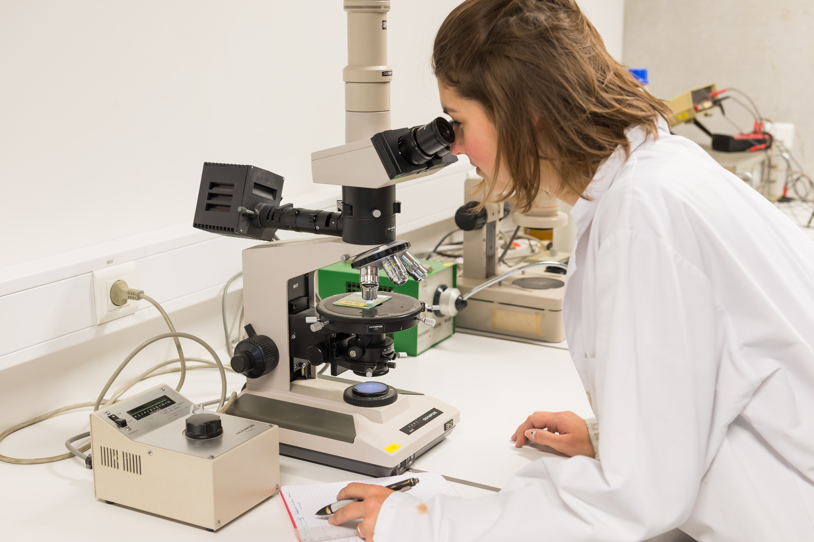
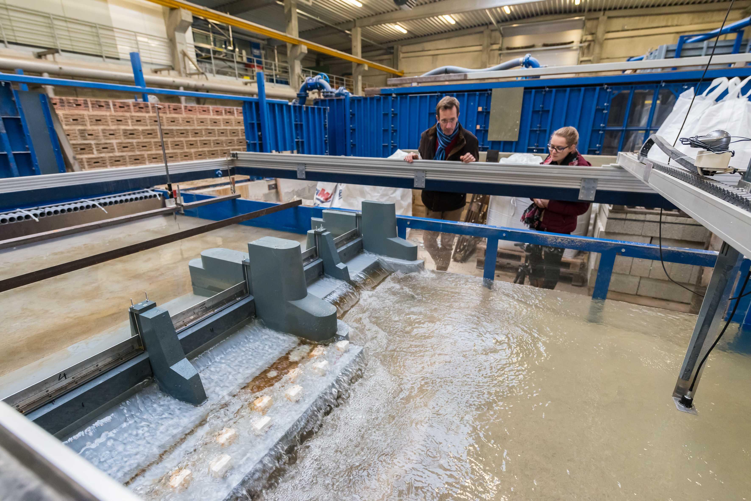
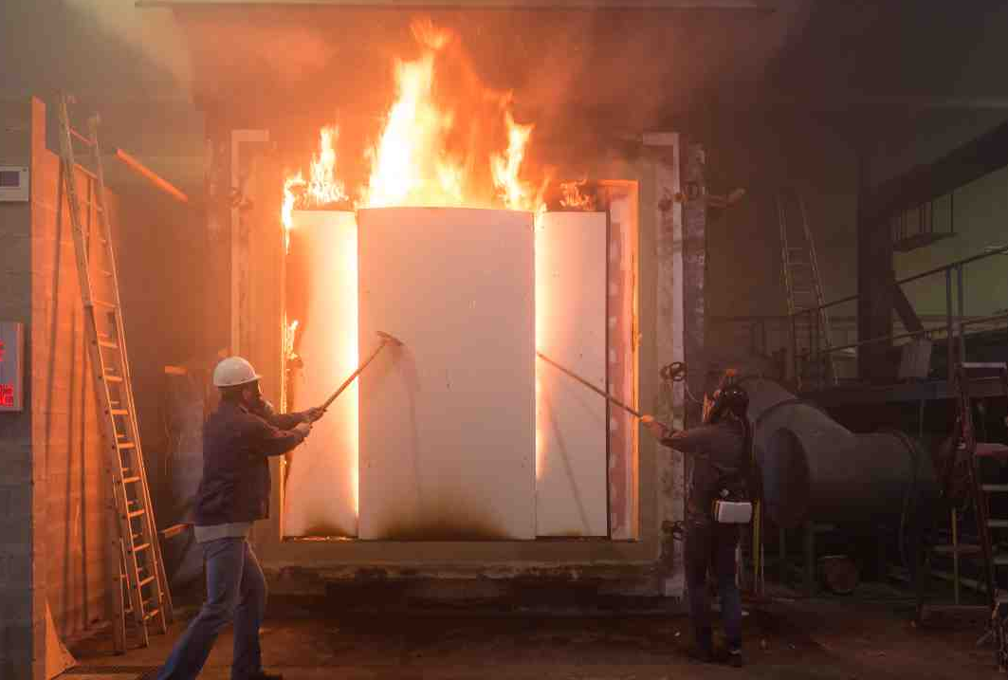
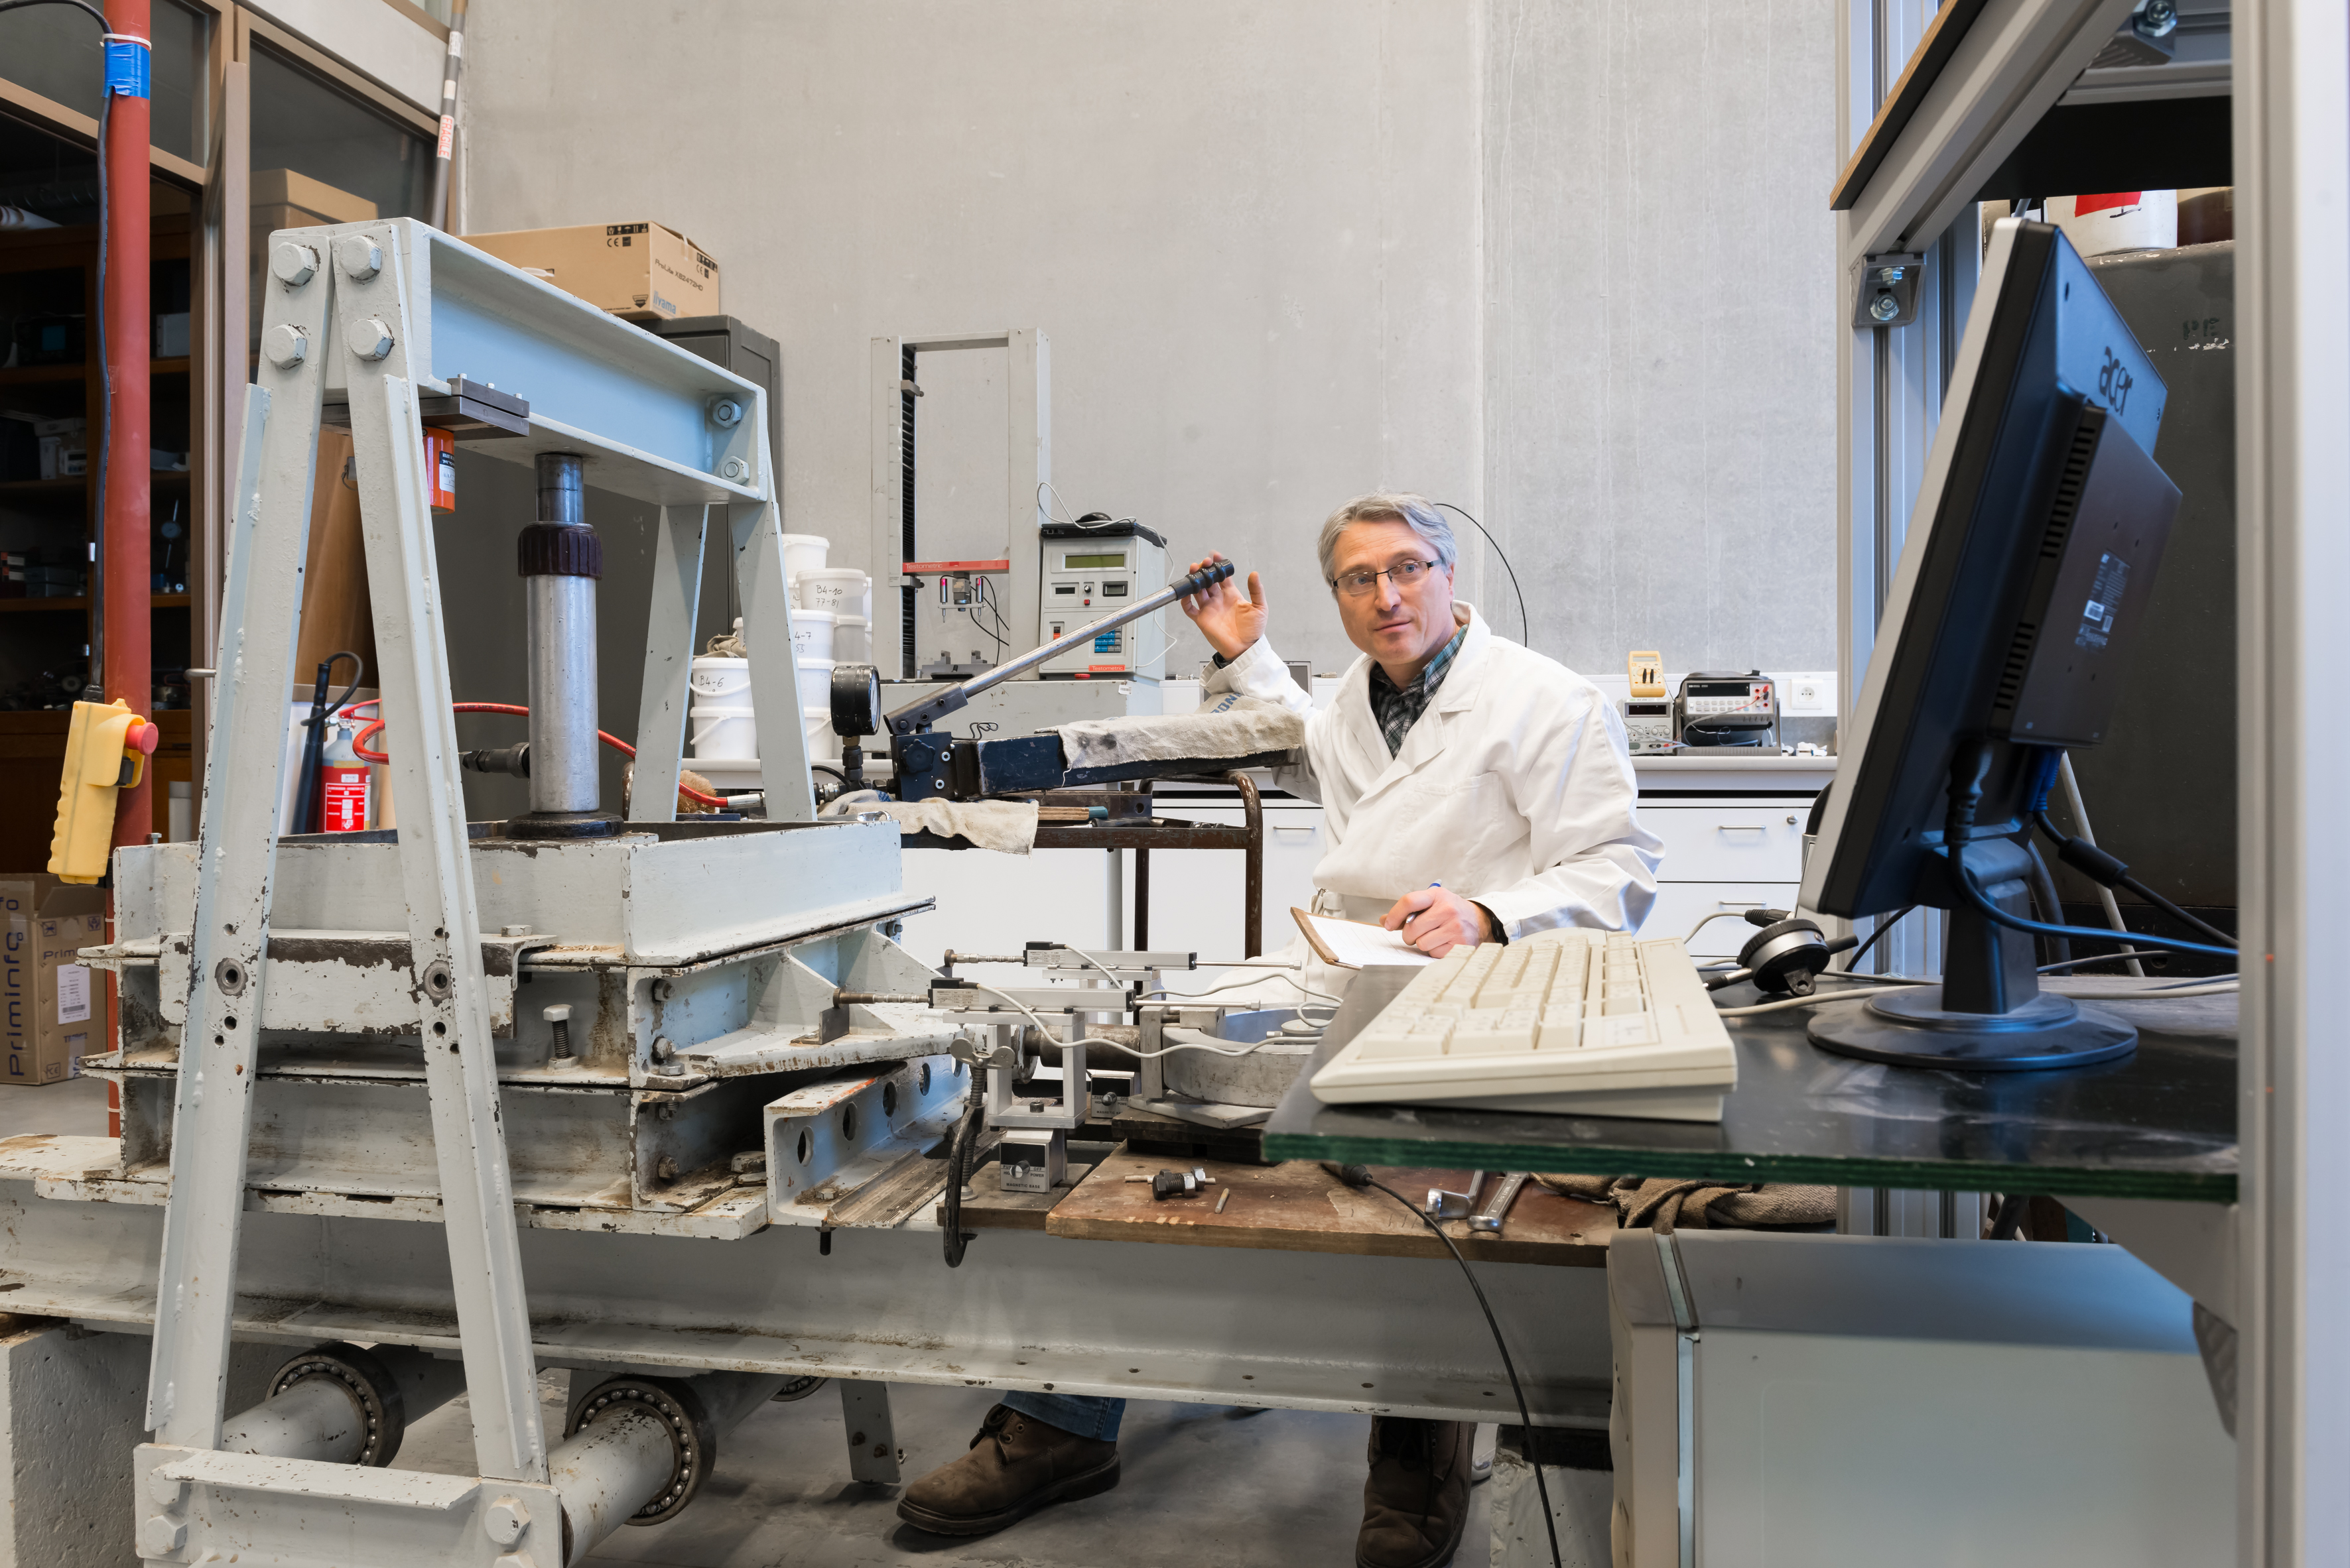
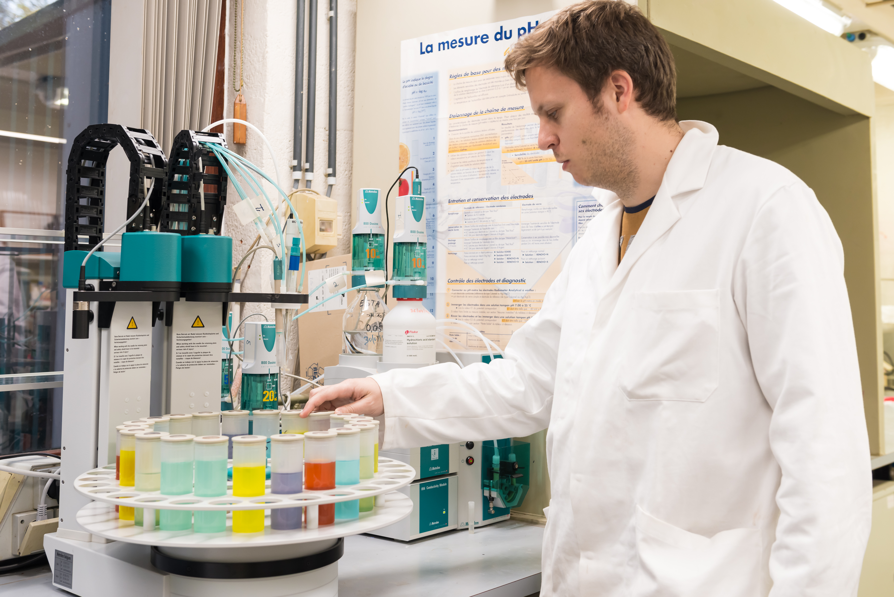
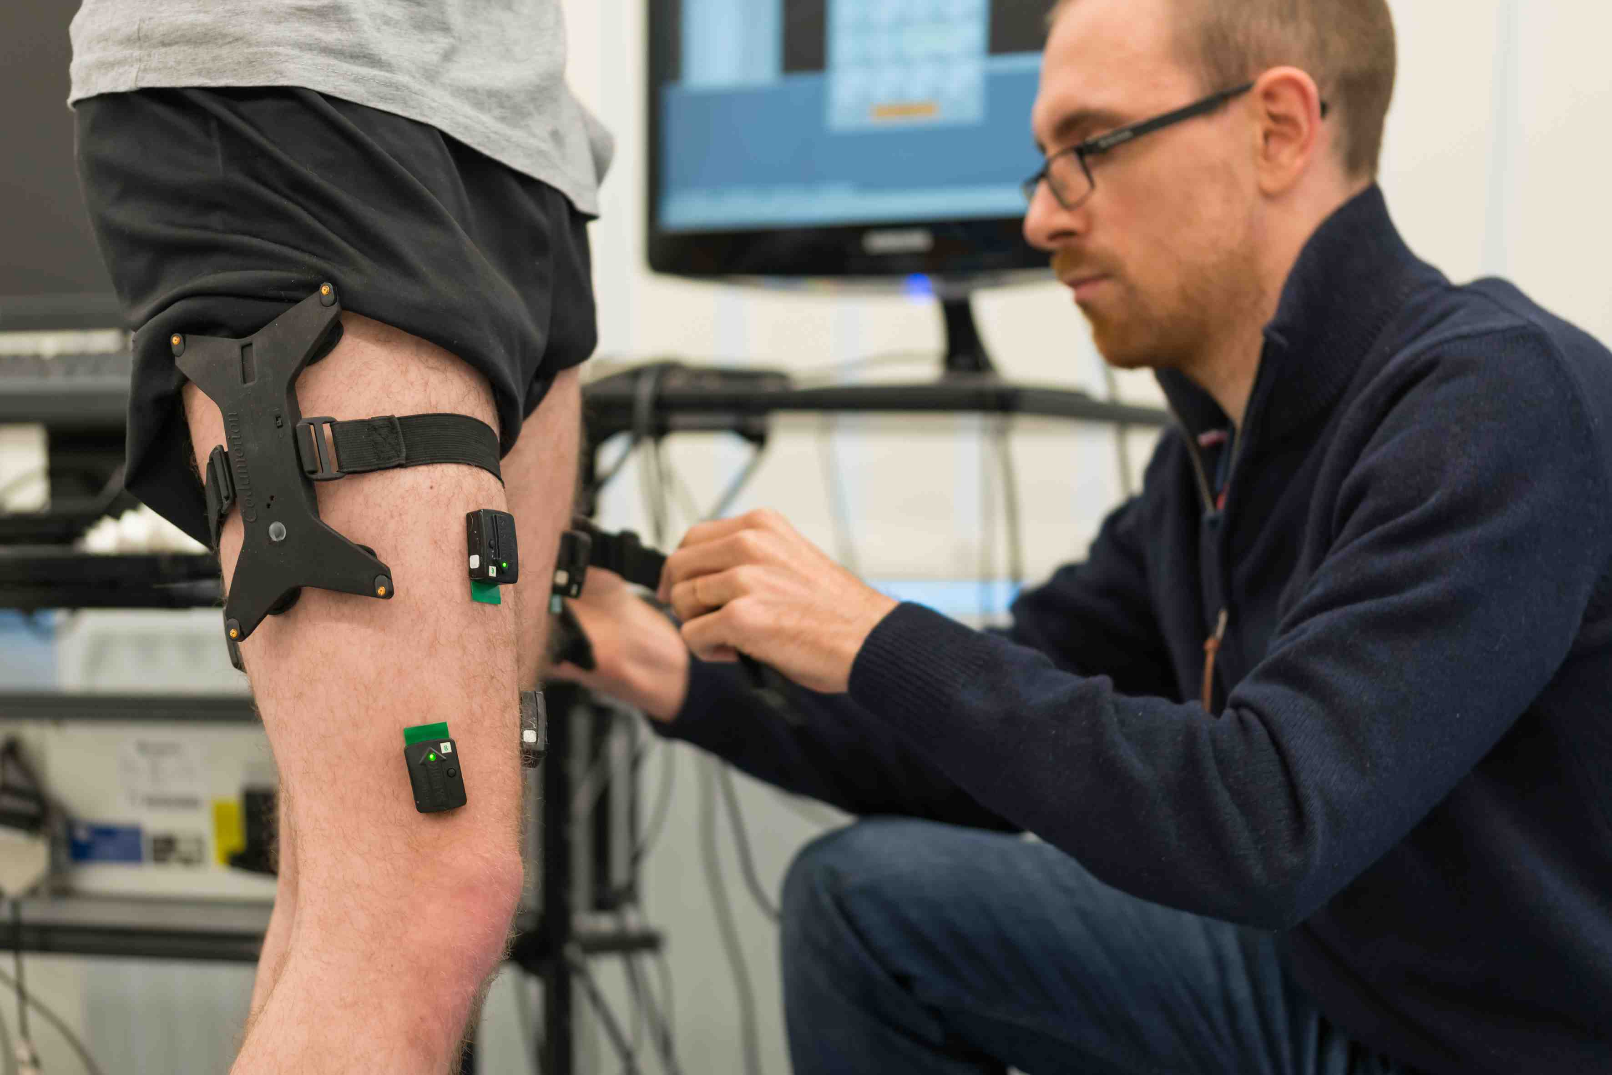
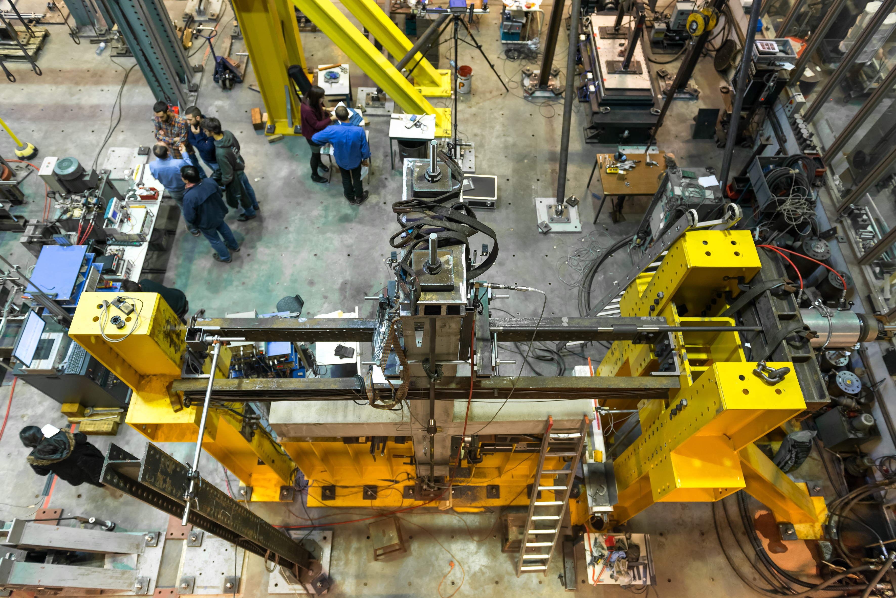
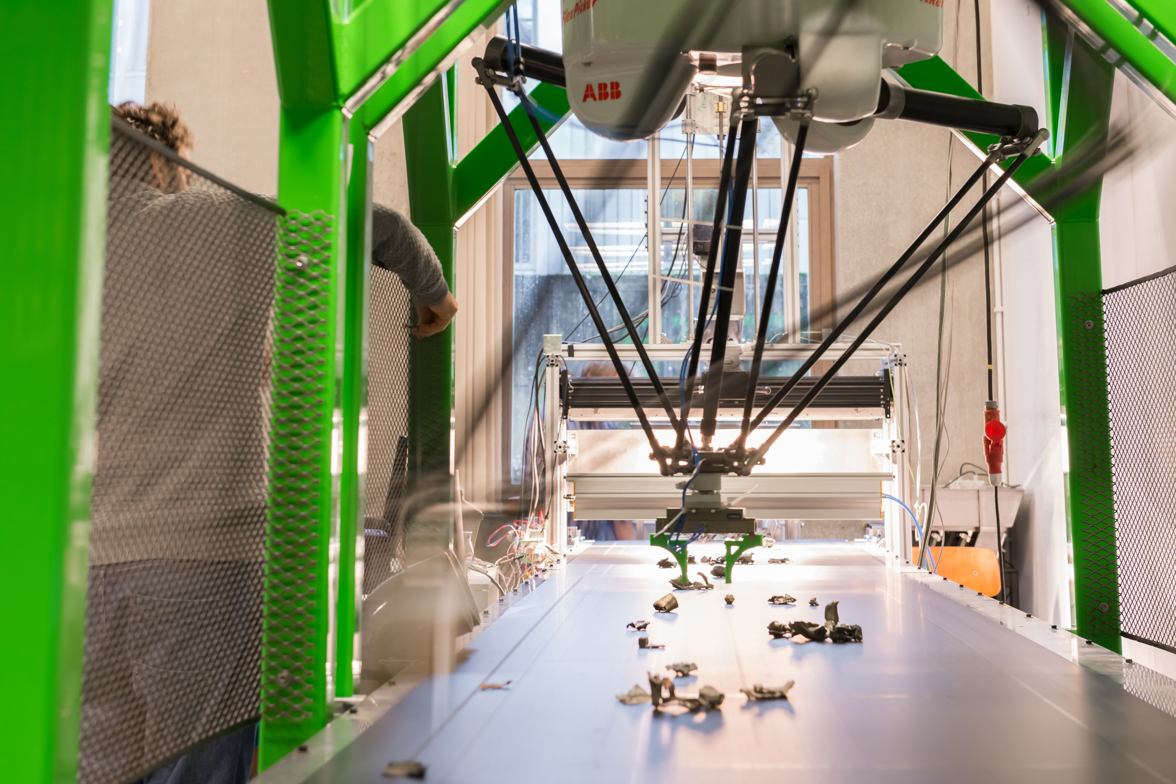
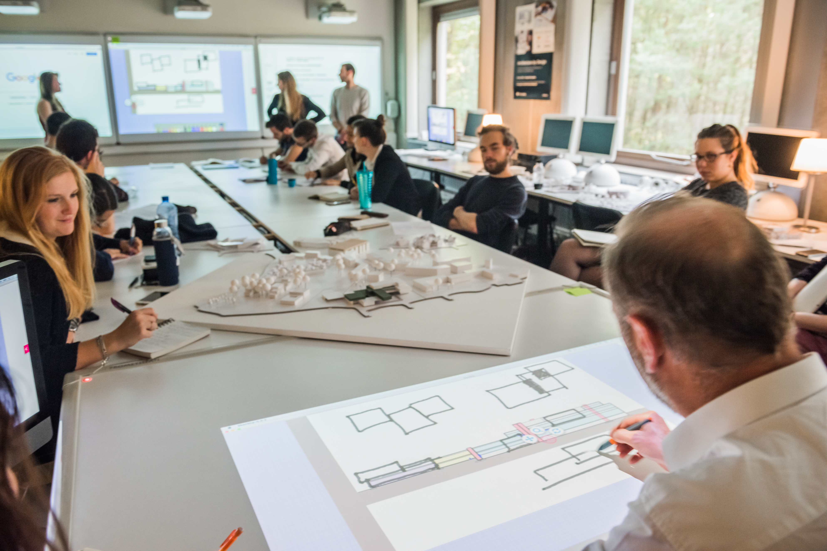
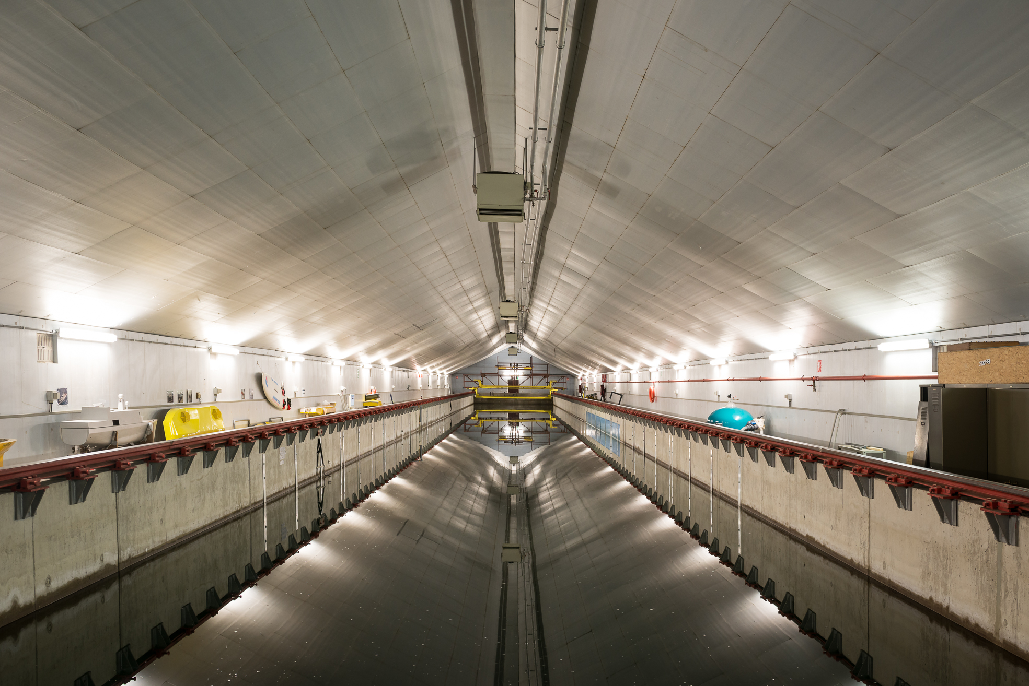
11 laboratories
Building Materials |  | Engineering Hydraulics |  | Fire Resistance Testing |  | Geotechnology |  | Inorganic Hydrochemistry
Human Motion Analysis | Materials and Structures |  | Minerals Engineering and Recycling |  | Digital Studio |  | Towing tank |  | Hydrogeophysics
Notes:
Agrandir légèrement les images

Slide 19
Four closely intertwined research axes
Notes:
Chiffres à actualiser

Slide 20
5 sectors
Notes:
Chiffres à actualiser

Slide 21
Notes:
PAGE IDENTITÉ FACULTÉ

